Slide 1
Work report
Feng Zhang
20180402

Slide 2
Background

Slide 3
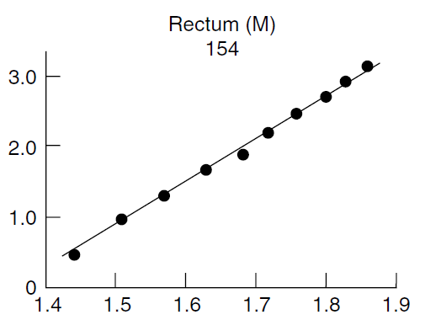
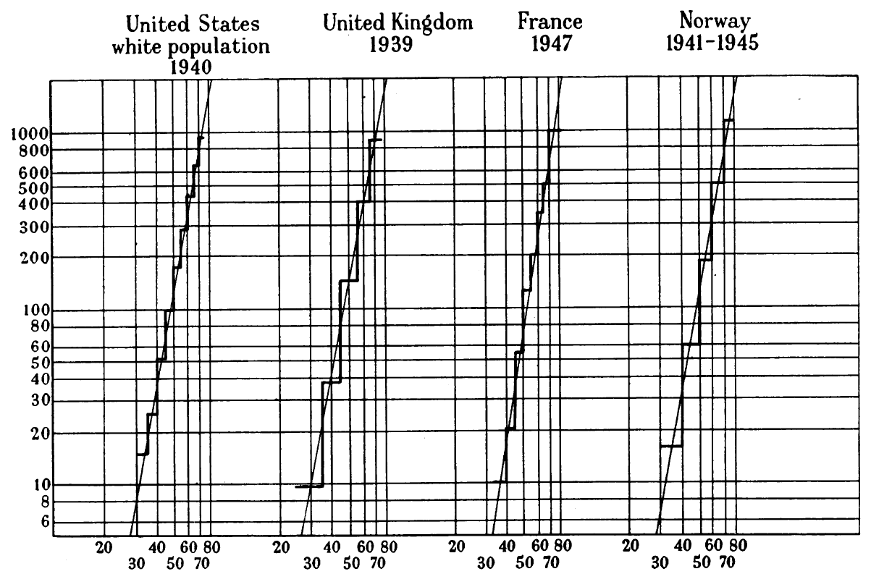
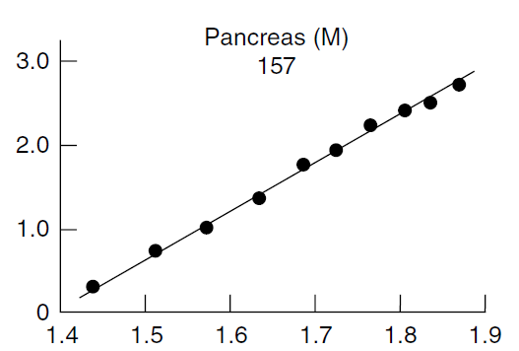
Initiation of multi-stage model
Deaths per 100,000 males
log/log scale
age
Nordling CO, Br J Cancer, 1953
P Armitage and R Doll, Br J Cancer, 1954

Slide 4
A brief derivation of multi-stage theory

Slide 5
Discovery & Hypothesis

Slide 6
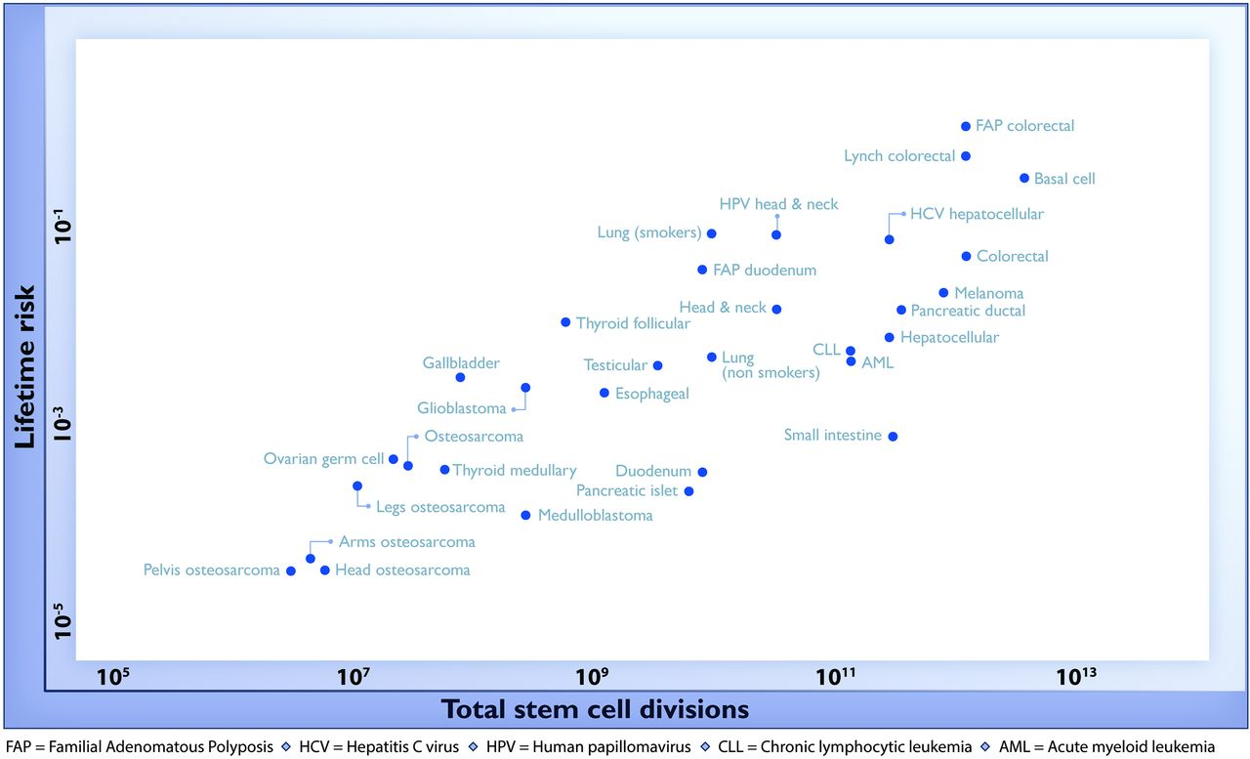
r = 0.81
Slope=0.53
Data of the USA
Tomasetti & Vogelstein, Science, 2015

Slide 7
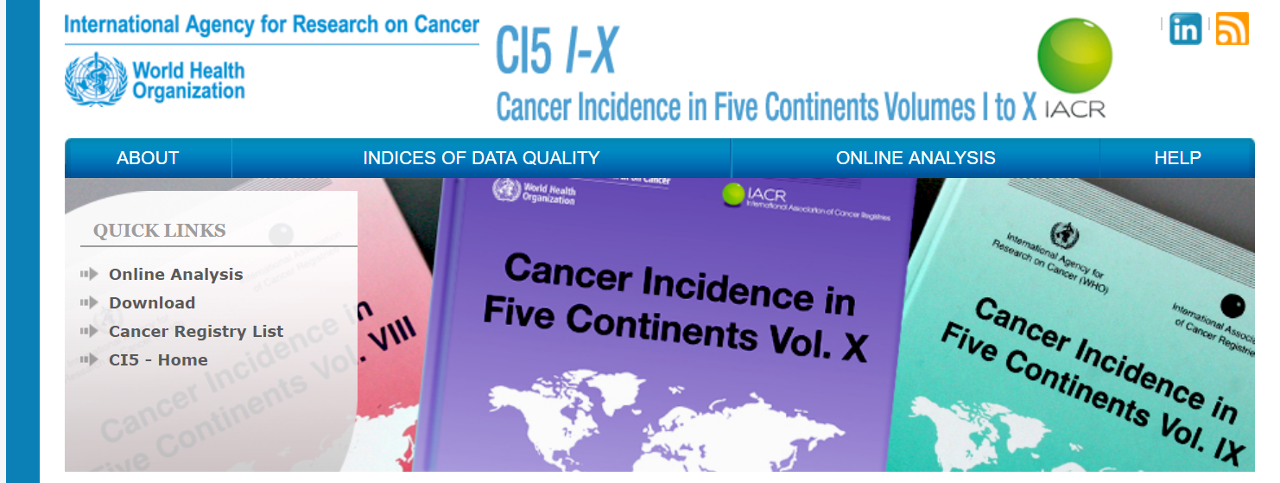
Data
2003-2007

Slide 8
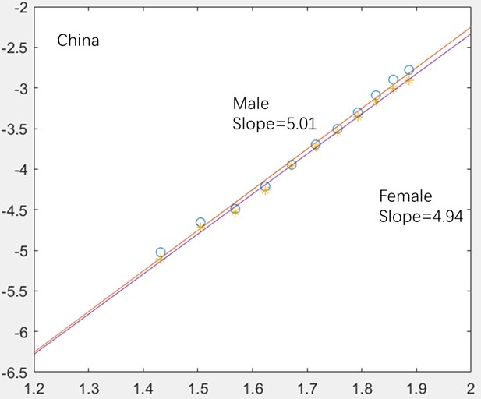
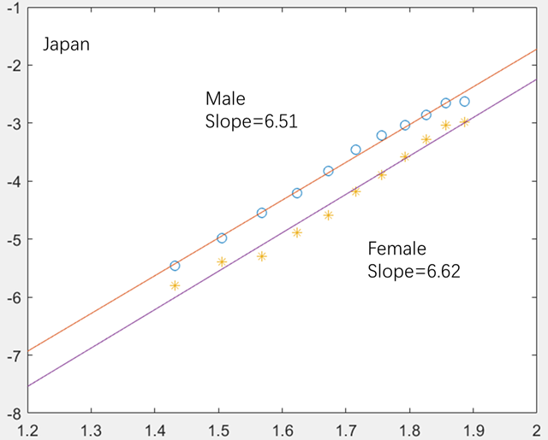
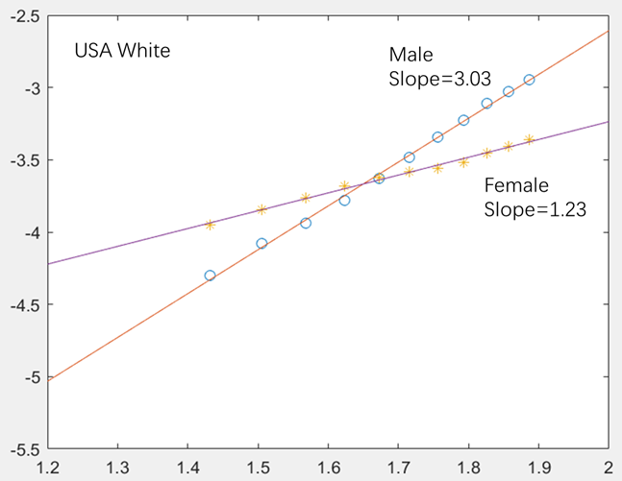
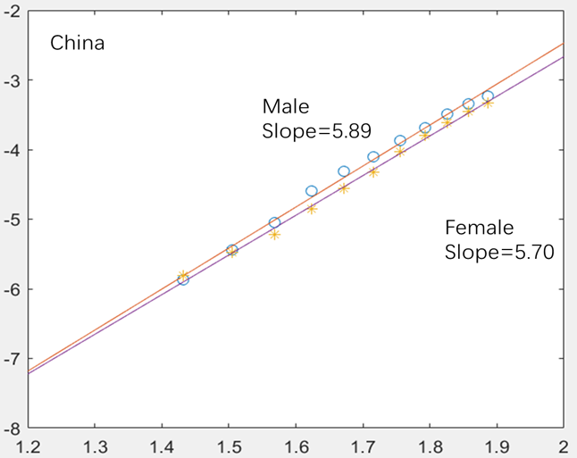
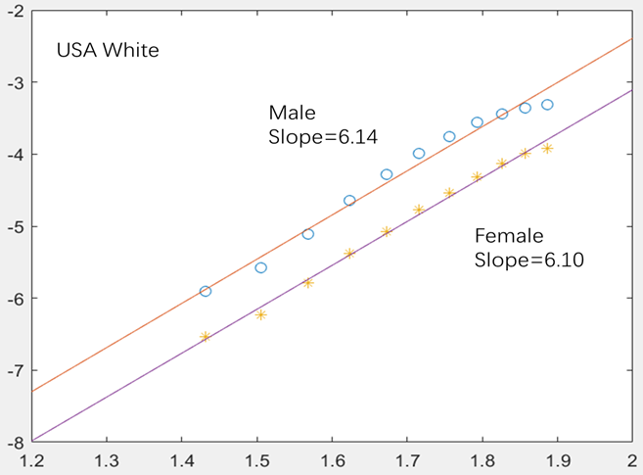
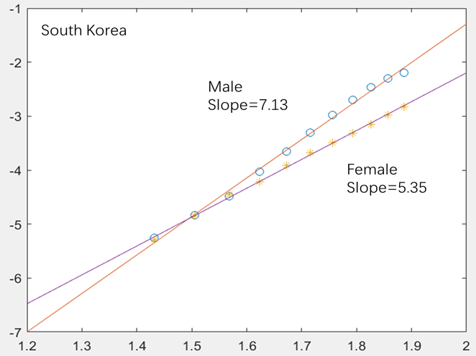
Three patterns
colon
liver
Melanoma
Pancreas
Oesophagus
lung

Slide 9
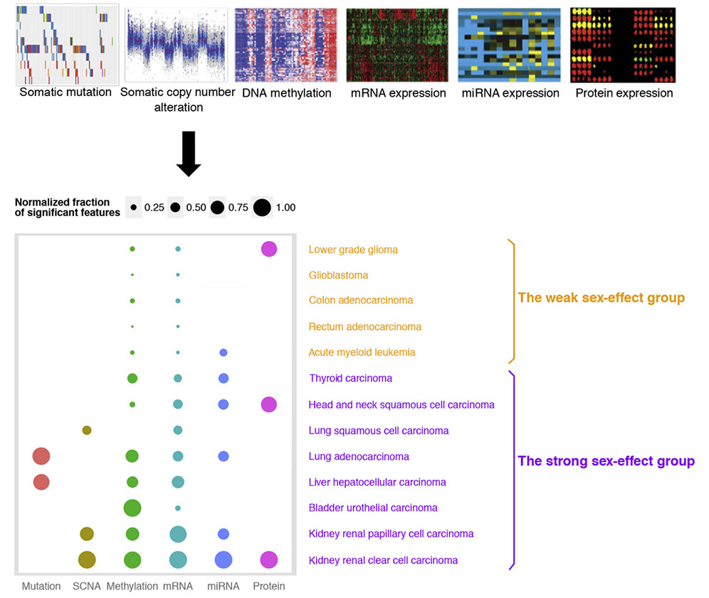
Pan-cancer analysis on gender bias
Yuan yuan et.al., Cancer cell, 2016

Slide 10
Validate the hypothesis

Slide 11
Procedure
Quantitative method to measure parallel or unparallel
Quantitative method to find Sex Biased Genes(somatic mutations & copy-number alterations)
Review the Sex-Biased Genes and give reasonable explanation
Functional verification

Slide 12
Validate the hypothesis
——parallel or not

Slide 13
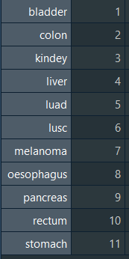
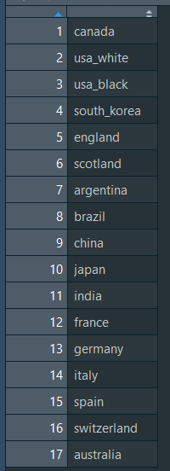
Data selected
Cancer selected:
Non-reproductive cancer
Carcinoma
TCGA project
Incidence
Country and race selected:
Population
Race
Data quality
Age selected: 30-70 years

Slide 14
Unparallel measurement

Slide 15
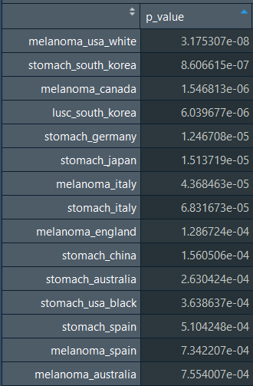
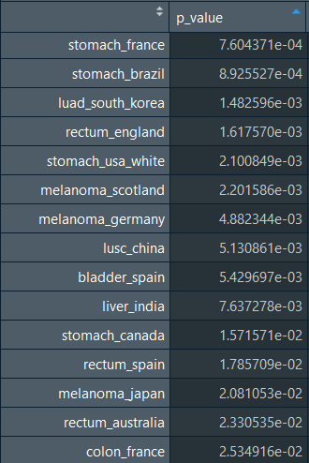
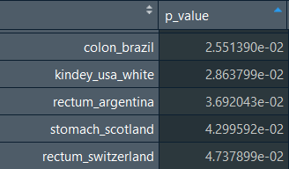
β₃ ≠ 0
Adjust p-value using ‘bonferroni’
Melanoma(white, japan)
Stomach
Lusc(southkorea, china)
Luad(southkorea)
Kindey(usa_white)
Liver(india)
Colon(france,brazil)
Rectum(England,spain,Australia,
switzerland)

Slide 16
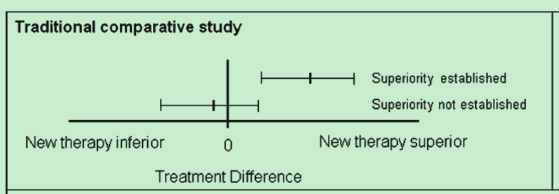

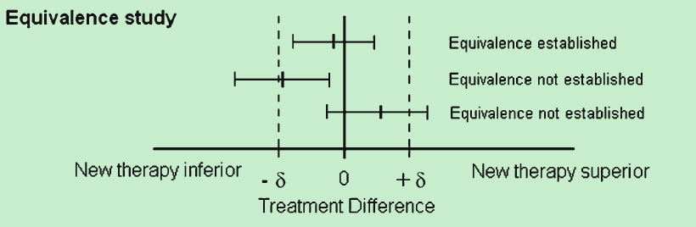
Parallel measurement—equivalence test
Walker et.al., J Gen Intern Med, 2010

Slide 17
Parallel measurement—equivalence test

Slide 18
Parallel measurement—Gao test

Slide 19
Parallel measurement—test result

Slide 20
Parallel measurement—test result
Bladder | Colon | Kidney | Liver | Luad | Lusc | Melanoma | Oesophagus | pancreas | Rectum
USA black | USA white | South Korea | Canada | USA black | Canada | South Korea | Canada | USA white | China
England | England | England | Italy | England |  | India | USA white | South Korea | USA black
India | China | Scotland |  | China |  |  | England | Argentina
 | India | Argentina |  | Japan |  |  | Scotland | Brazil
 |  | China |  | Switzerland |  |  | China | China
 |  | Japan |  |  |  |  | Germany | France
 |  | Germany |  |  |  |  | Italy | Germany
 |  | Italy |  |  |  |  | Australia | Italy
 |  | Australia |  |  |  |  |  | Spain
 |  |  |  |  |  |  |  | Australia

Slide 21
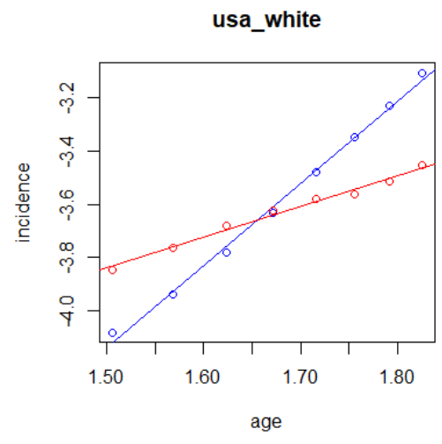
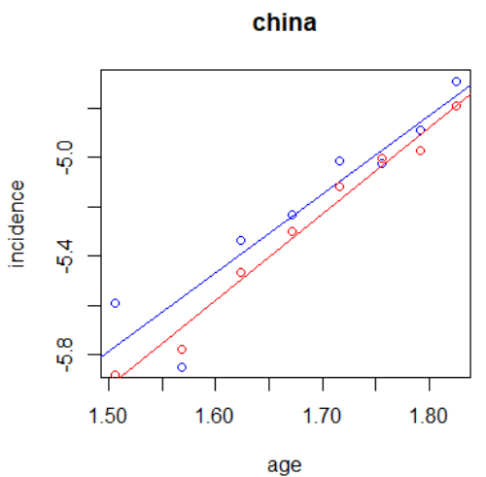
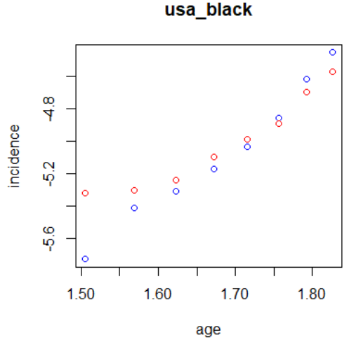
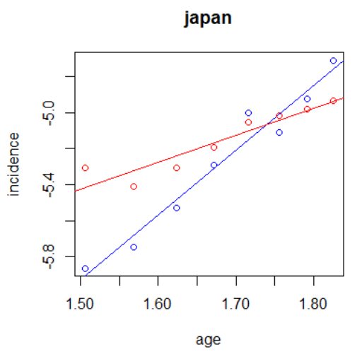
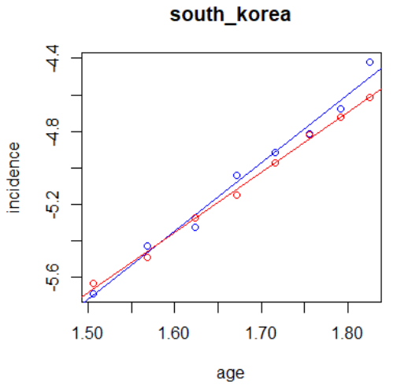
Melanoma
Male
Female
1
0 parallel
1 unparallel
1

Slide 22
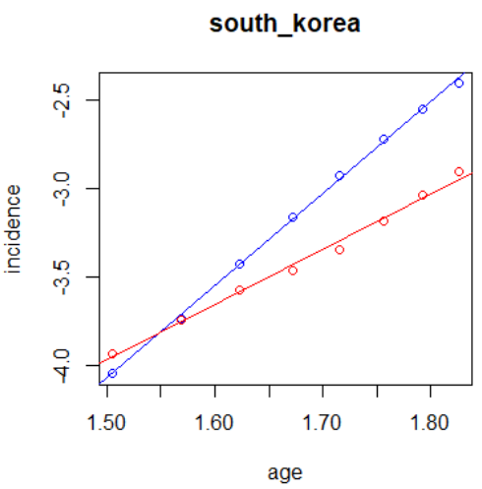
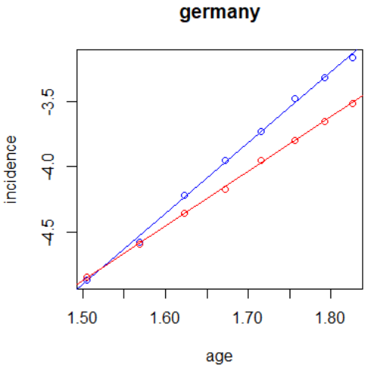
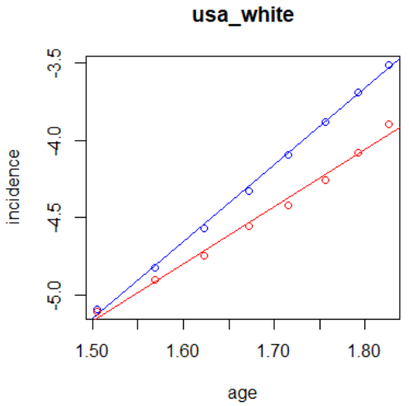
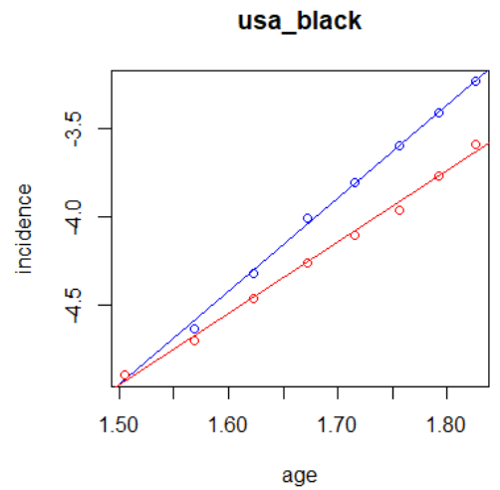
Stomach
1
1
1
1

Slide 23
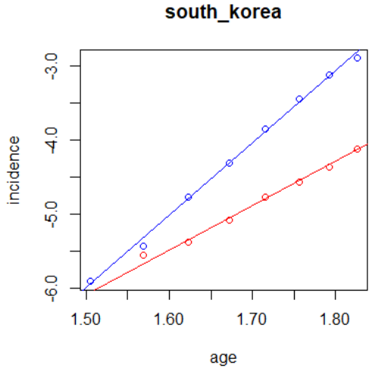
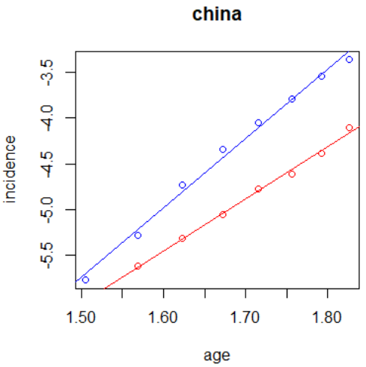
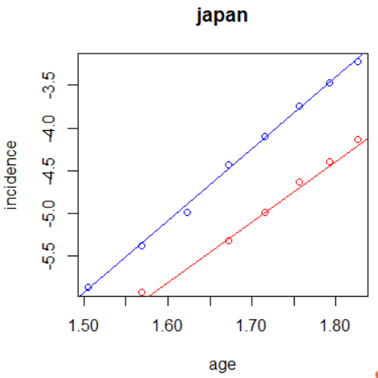
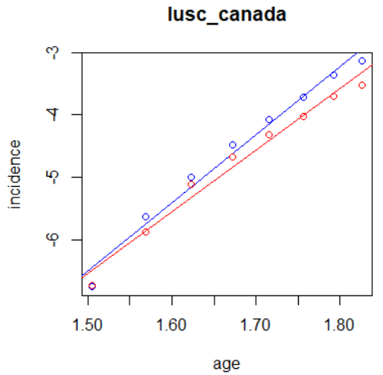
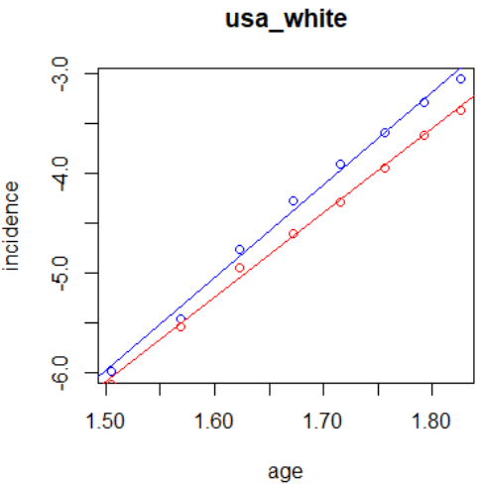
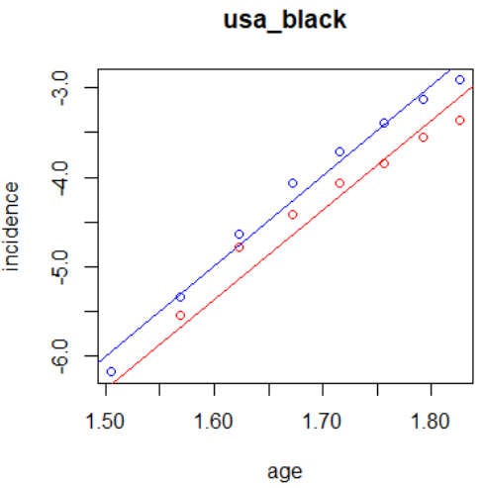
Lusc
1
1
0

Slide 24
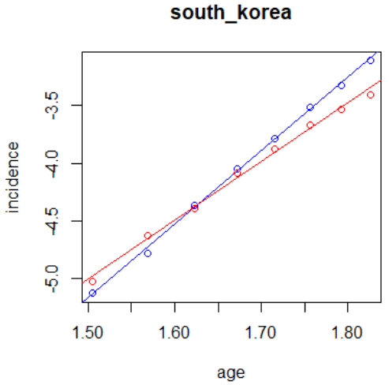
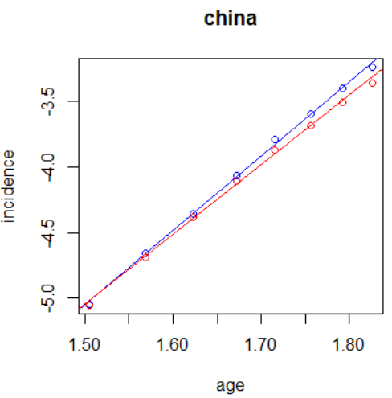
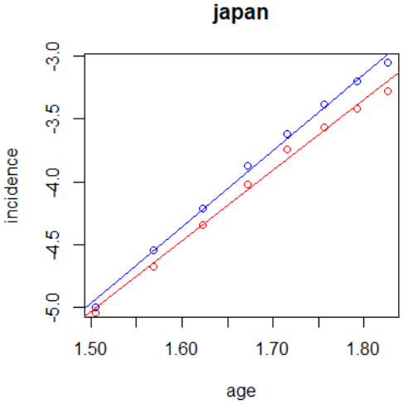
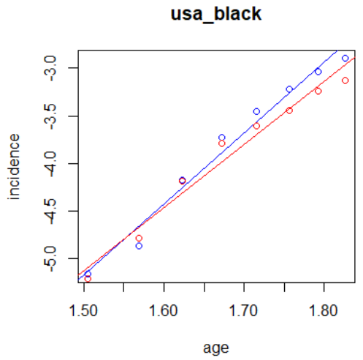
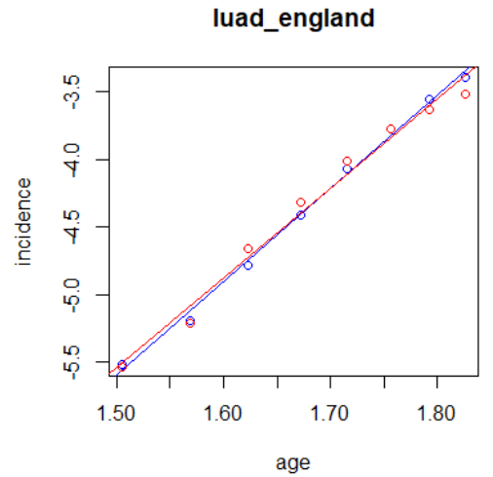
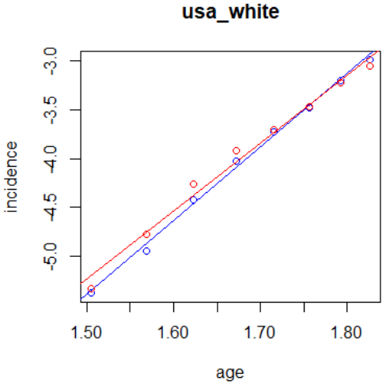
Luad
1
0
0
0
0

Slide 25
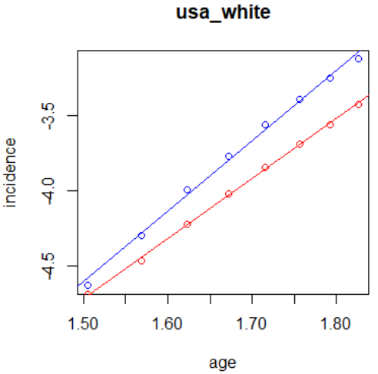
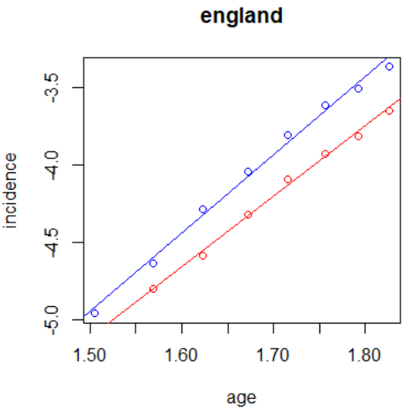
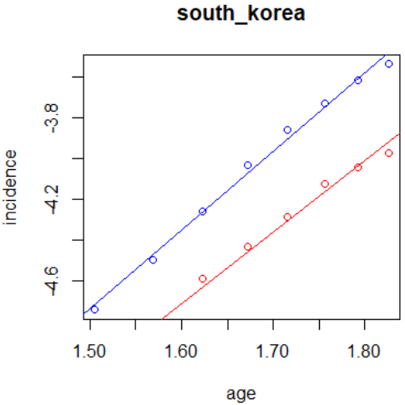
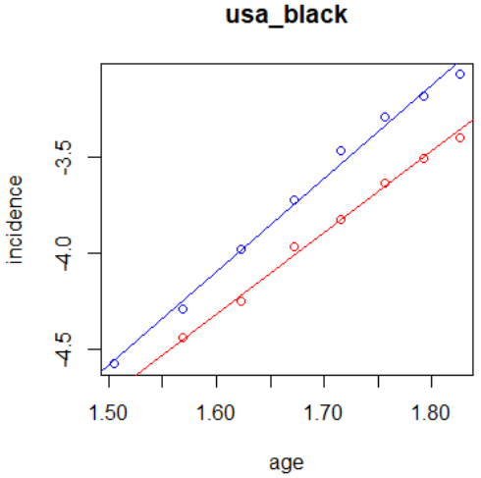
Kidney
1
Δβ≈0.5
0
0

Slide 26
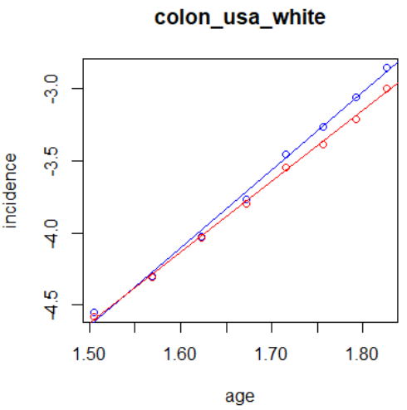
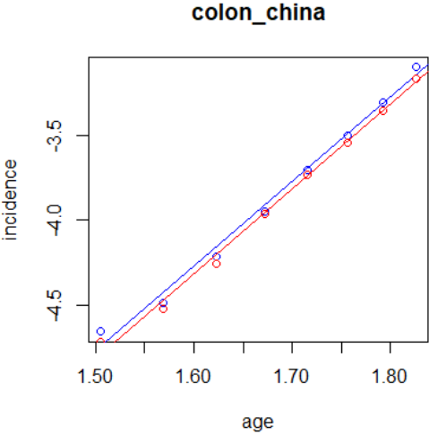
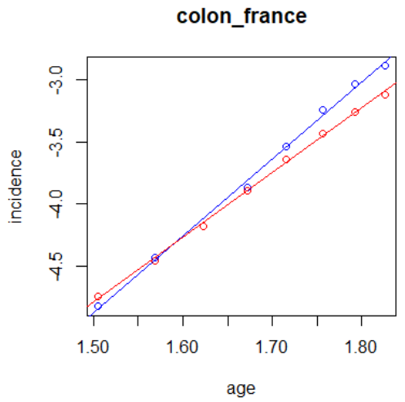
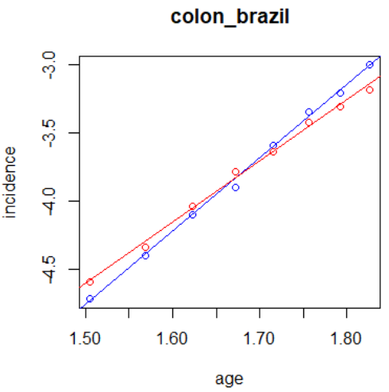
Colon
0
0
1
1

Slide 27
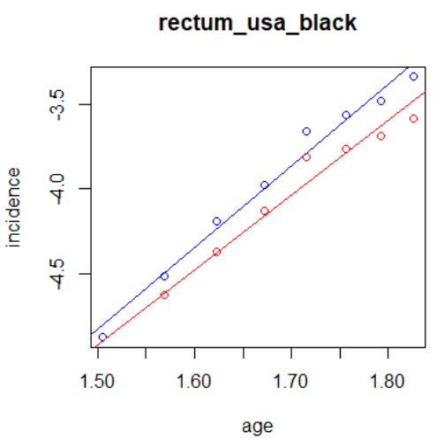
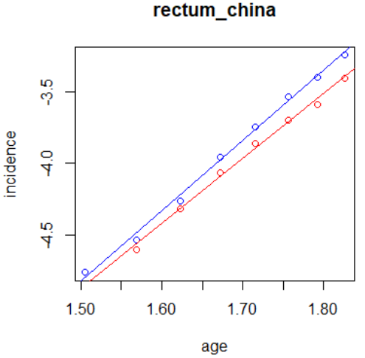



Rectum
0
0
1
1
1

Slide 28





Liver
1
0
0

Slide 29
Validate the hypothesis
——Sex Biased Genes

Slide 30
TCGA data
Cancer selected:
Non-reproductive cancer
Carcinoma
TCGA project
Incidence

Slide 31





Procedure
.MAF
ESCA.maf
ESCA1.maf
Delete "Silent“, "Intron“, "IGR"
Clinical data
Gender
White
Unduplicated
ESCA4.maf
ESCA3.maf
ESCA2.maf
Count
ESCA male.maf
Frequency table
ESCA female.maf

Slide 32

Statistic test
Frequency table
Chisq.test
P value adjust method=“bonferroni”

Slide 33



Result
Melanoma
Stomach
Lusc
1
1

Slide 34
Validate procedure——future plan
Quantitative method to measure parallel or unparallel
Quantitative method to find Sex Biased Genes(somatic mutations & copy-number alterations)
Review the Sex-Biased Genes and give reasonable explanation
Functional verification

Slide 35
C&R&H
If there is sex/race bias mutated driver gene for some cancer type?
Why these genes are sex bias selected in cancer initiation? what are their function?
Challenge
Epidemiology + Mathematical model + Bioinformatics
Review + Function verification
Response
Find some sex bias mutated genes
Explore their function and learn more about cancer initiation
potential drug target
Highlight

Slide 36
Acknowledgement
Supervisor:
Ge Gao
Jinzhi Lei
Xianjin Xie
Chao Tang
Xiaojing Yang
Feng Liu
Yuan Lin
Feng Tian
Shuai Jiang
Sijin Cheng
Dechang Yang
Yihang Shen
Shen Jin
Chang Chang
Shanshan Qin
Xiang Liu

